Slide 1
DISTRIBUTED OS
A distributed computing system consisting of several autonomous computers connected by a communication network
An identical copy of OS runs on every computer
Transparency must be ensured.
System should be viewed as a virtual uniprocessor.

Slide 2
Issues in distributed operating system
1.Global Knowledge
2.Naming
3.Scalability
4.Compatability
5.Process Synchronization
6.Resource Management
Data Migration
Computation Migration
Distributed Scheduling

Slide 3
7.Security
8.Structuring
a.The Monolithic Kernal
b.The Collective Kernal Structure
c.Object Oriented Operating System
9.Client-Server Computing Model

Slide 4
1.Global knowledge
Unavailability of global clock
Implement decentralization
Temporal ordering of events.
Absence of global knowledge about state of the computers and their communication links,arriving at a consensus in distributed systems is a significant challenge.

Slide 5
2.Naming
Are used to refer to objects
Eg of service is a name service
In distributed system the directories will be replicated
2 main drawbacks of replication
NB.Partition directory- is a contiguous portion of the overall directory that has independent replication scope and scheduling data

Slide 6
3.Scalability
System growth is inevitable
So additional care should be given for the implementation of scarce resources

Slide 7
4.Compatibility
Refers to the notion of interoperability among the shared resources in a system
Three execution level of compatibility are binary level,the execution level,protocol level.
Eg of binary level-Emerald systems
Eg of execution level-Andrew and Athena

Slide 8
5.Process Synchronization
Shared resource be accessed by a single resource.

Slide 9
6.Resource Management
Concerned with making use of both local and remote resources available to user in effective manner.
Specific location of resource should be hidden from user.
The resources of Distributed system are made available to users in the following ways: data migration,computation migration, and distributed scheduling

Slide 10
a.Data Migration
In the process of data migration,data is bought to the location of the computation that needs access to it by the distributed operating system.
Distributed file system allows network transparency.
Distributed shared memory-provides virtual space.
Distributed shared memory don’t have physical shared memory
Major problems-mainatenance of consistency of shared data and the minimization of delays.

Slide 11
b.Computation Migration
Send a message and receive a data.
In distributed system one computer may require another computer;s status(eg.load level)
RPC mechanism

Slide 12
c.DISTRIBUTED SCHEDULING
Processes are transferred from one computer to another by the distributed OS.
That is,a process may be executed at a computer different from where it is originated
Is responsible for judiciously and transparently distributing processes amongst computers that the overall performance is maximized.

Slide 13
7.Security
Authentication
Authorization

Slide 14
8.Structuring
How various parts of the OS are organized.
a.The monolithic kernal
Diskless workstation
b.The collective kernal structure
OS is structured as a collection of processes that are largely independent of each other
Microkernal approach
Policy and mechanism seperation

Slide 15
c.Object oriented operating system
Various services provided by an OS can be realized as a set of processes.
Another popular approach to implement the service as objects.
Each object encapsulates a DS and set of operations on DS
Eg) Eden,choice,Ameoba

Slide 16
9.Client-Server Computing Model
Client server mechanism
In multiple server the case is a bit different
Clients typically uses cache

Slide 17
COMMUNICATION NETWORK
LAN
WAN

Slide 18
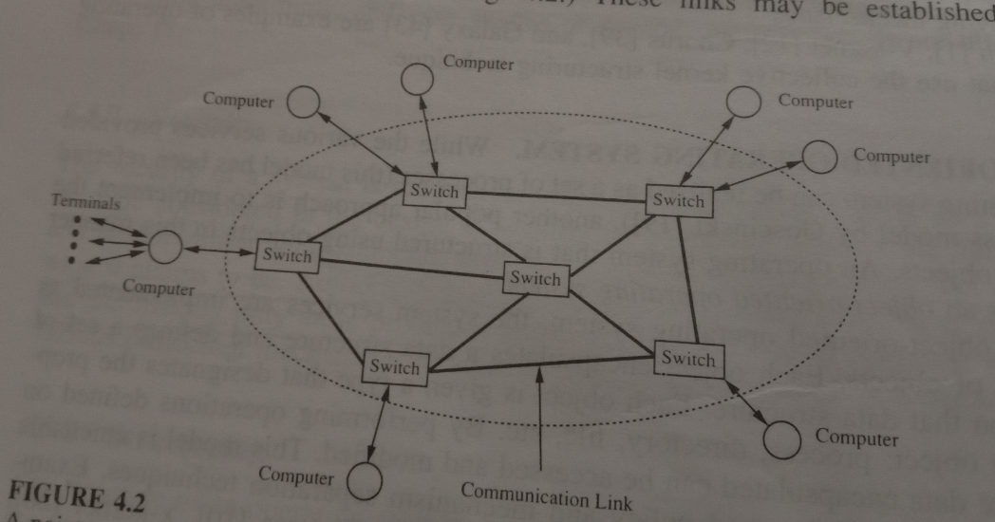
WAN(Long Haul Networks)
Communication network contains switches
Store and forward mechanism is used.

Slide 19
Packet VS Circuit Switching
These are two modes of communication network.
Circuit switching
a dedicated path is established between two dveices wishing to communicate and the path remains intact for the entire duration throughout the communication.
Eg:) telephone system

Slide 20
Packet Switching
Connection is established between the source device and its nearest switch.
Data is broken into small units called packets with each packet containing the address of the destination
Not a fixed or established communication path but rather t is dynamically shared among many devices on demand basis,Hence its connectionless.
High utilization of communication network.
Also parallel transmission so that packet from one message may travel across different paths.
Disadvatage-cost due to breaking of the messages and reassembling.

Slide 21
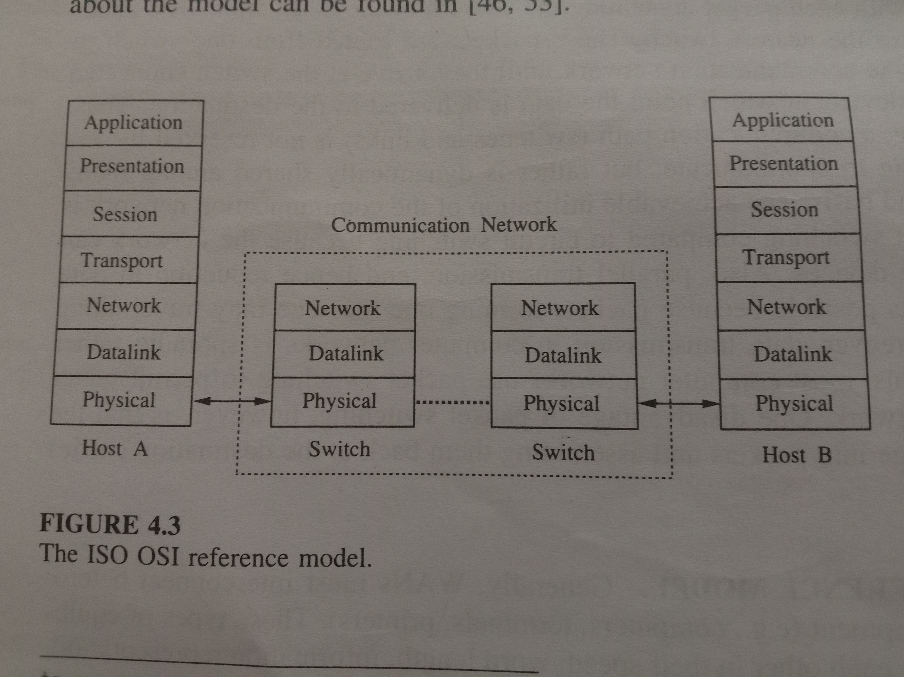
ISO-OSI MODEL
To communicate in a heterogenous environment
Seven layers

Slide 22
Each layer is aware only of the protocol and header formats of its counterparts
Layer independent

Slide 23
An overview of the ISO OSI Layers
Physical layer-transmission of raw bits.how bits are organized.
Data link layer-responsible for recovering from transmission errors and flow control
Network layer-routing and congestion control
Transport layer-hide all the details of the communication network from the layers above.
Session layer-establishing and maintaining a connection
Presentation layer-interface between a user program and the rest of the network.
Application layer-facility for the user processes to use the ISO-OSI protocols.

Slide 24
LAN
High data transmission rates
The geographical scope of LAN is small
Low transmission error rate
Widely used topology-Bus,Ring and tree
Communication media-coaxial cable,twisted pair or optical fibre

Slide 25
Bus Topology
Transmits message in the form of packets.
Bus topology is a type of network topology in which each included node is connected to a single main cable which acts as the backbone of the network. ... In tree topology, the nodes are organized in the form of a tree. In bus topology, each included node is connected to a single cable which is known as the backbone.

Slide 26
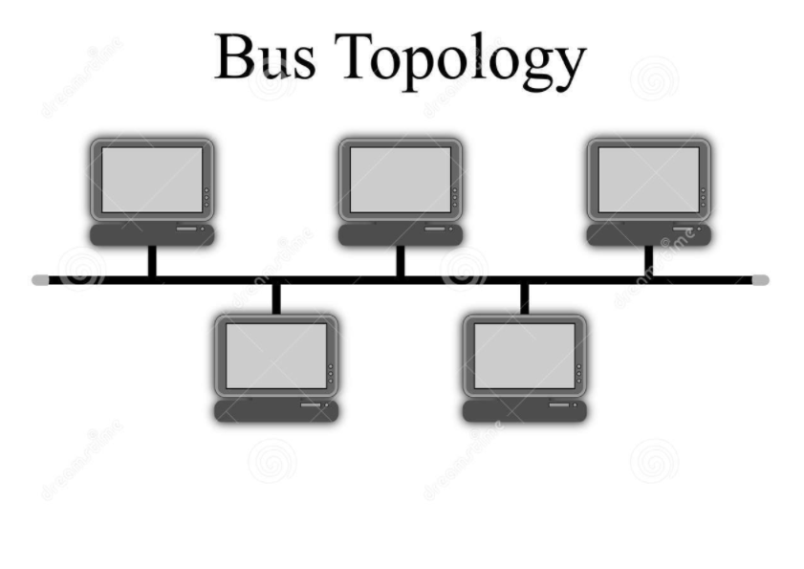
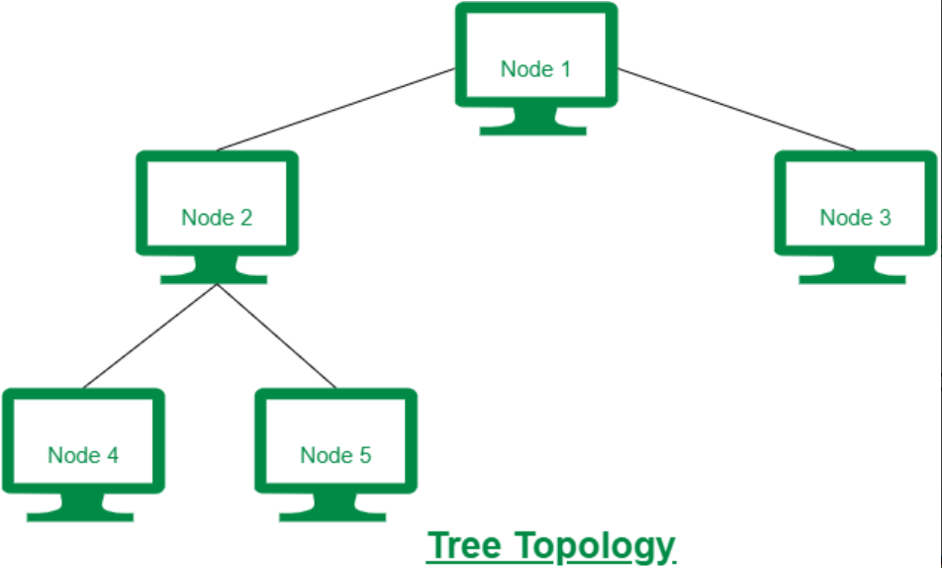

Slide 27
CSMA/CD (Carrier sense multiple access with Collision Detection)
Initially listens to medium
Listens whether the transmission is in progress
If so waits for random amount of time
If no transmission device sends data and also listens to the medium
Collision-sends jamming signals all over
Advantage-simplicity
Disadavantage-performance degradation
Eg- Ethernet

Slide 28
Tree toplology
Packets transmitted by one device to another will not enter the common bus unless the destination device is on another branch of the tree.
The common bus act as a backbone in many LANs

Slide 29
Token Bus protocol
Here a logical ring is formed.

Slide 30
Ring toplogy
The token Ring Protocol
The slotted ring protocol

Slide 31
Communication Primitives-High level constructs.
The two communication models are:
1.The message Passing Model
2.The remote Procedure Calls

Slide 32
The message Passing Model
Basically provides two communication primitives namely SEND and RECEIVE
SEND primitive has two parameters a message and the destination
RECEIVE primitive has two parameters ,the source of a message and a buffer for storing the message
Application can be seen in client server model.

Slide 33
Semantics of Send and Receive-Blocking vs Non blocking Primitives
In standard message passing the message are copied three times
1.From the user buffer to the kernel buffer
2.From the kernel buffer on the sending computer to the kernel buffer on the receiving computer
3.From the buffer on the receiving computer to a user buffer
This is known as the buffered option.

Slide 34
Non blocking primitives
Non blocking primitives with buffered option
Non blocking primitives with unbuffered option
Eg for non blocking communication occurs in producer-consumer relationships
Non blocking receive-issued by consumer process
Non blocking send-issued by producer process

Slide 35
Blocking Primitives
Unreliable blocking primitive
Reliable blocking primitive

Slide 36
Synchronous Vs Asynchronous Primitives
Synchronous
Send primitive is blocked until a corresponding receive primitive is executed at the receiving computer.This is known as rendezvous.
Asynchronous-messages are buffered

Slide 37
Remote Procedure Calls
Message passing model should implement the following
Painting of responses with request messages
Data represenatation
Knowing the address of the remote machine or the server
Taking care of communication and system facilities
RPC works on procedure calls or shared memory system.

Slide 38
Basic RPC operation
On invoking a remote procedure the calling process(the client) is suspended and the parameters if any are passed to the remote machine (the server) where the procedure will get executed.
On completion of the procedure execution the results are passed back from the serve to the client and client resumes.

Slide 39
Issues In RPC mechanism
Structure
Binding
Parameter and result passing
Error handling,semantics and correctness
Other issues

Slide 40
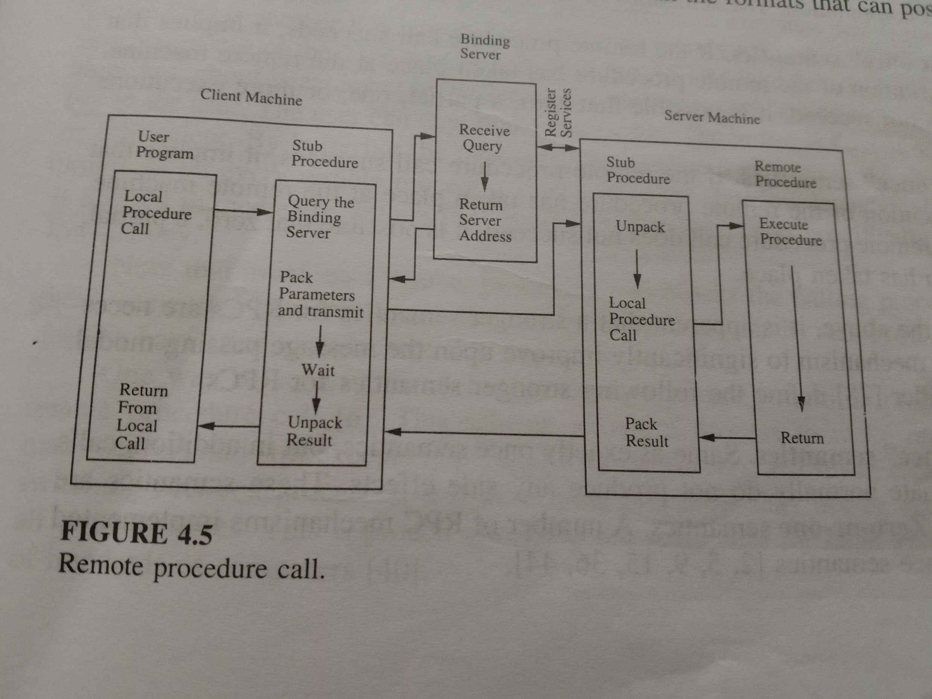
1.Structure

Slide 41
Based in concept of stub procedures
Stub procedure sends the message
Client procedure receives the message

Slide 42
Binding
Binding is a process that determines the remote procedure and the machine on which it will be executed,upon a remote procedure invocation.
Compatability checking
Binding in the client server model makes use of a binding server.
The binding server essentially stores the server machine address with the services.

Slide 43
Parameter and result passing
To pass parameters or results to a remote procedure , astub procedure has to convert the parameters and results into an appropriate representation first and then pack them in a buffer in form suitable for transmission.
Conversions has to be avoided on every call.One way to avoid conversions is to send the parameters along with a code identifying the format used so that the receiver can do the conversion
Each data type may have a standard format in the message.
In this technique sender will convert data to the standard format and the receiver will convert from the standard format to its local rep.

Slide 44
With this approach a machine does not need to know how to convert all the formats that can possibly be used.
This method however is wasteful, if both the sender and the receiver use the same internal representation.
Another method to pass parameter is by value and reference.

Slide 45
Error handling,semantics and correctness
Can fail for two reasons: communication failures and communication failures
Orphans-the unwanted executions
The semantics of RPC is classified are classified as follows
“At least one semantics”
“Exactly one semantics”
“Atmost one semantics”

Slide 46
Correctness Condition
Let Ci denote a call made by a machine and Wi represent the corresponding computation invoked at the called machine.
Let C2 happen after C1(denoted by C1->C2) and computations W1 amd W2 share the same data such that W1 and/or W2 modify the shared data.
C1->C2 implies W1->W2

Slide 47
Other issues

Slide 48
Lamport’s Logical Clocks
Lamport proposed the following scheme to order events in a distributed system using logical clocks.
The execution of processes is characterized by a sequence of events
The execution of a procedure could be one event or the execution of the instruction could be one event.
When processes exchange messages sending a message constitute one event and receiving a message constitutes on event.

Slide 49
The order in which two events occur at two different computers cannot be determined based on the local time at which they occur.
But based on the underlying computation certain events will occur.
We next define a relation that orders events based on the behaviour of the underlying computation.

Slide 50
HAPPENED BEFORE RELATION(->)
The happened before relation captures the causal dependencies between events,
Ie.whether two events are casually related or not.
The relation -> is defined as follows.
a->b if a and b are events in the same process and a occurred before b.
a->b, if a is the event of sending a message m in a process and b is the event of receipt of the same message m by another process.
If a->b and b->c,then a->c,ie “->” relation is transitive
Casually relative events(those events that can be ordered by ‘→’) is referred to as causal effects

Slide 51
CAUSALLY RELATED EVENTS
Event a causally affects event b if a-→b.
CONCURRENT EVENTS
Two distinct events a and b are said to be concurrent
(denoted by a||b) if a not tends to b and b not tends to a.In other words,concurrent event do not causally affect each other.
For any two events a and b in a system,either a→b,b→a,or a||b.

Slide 52
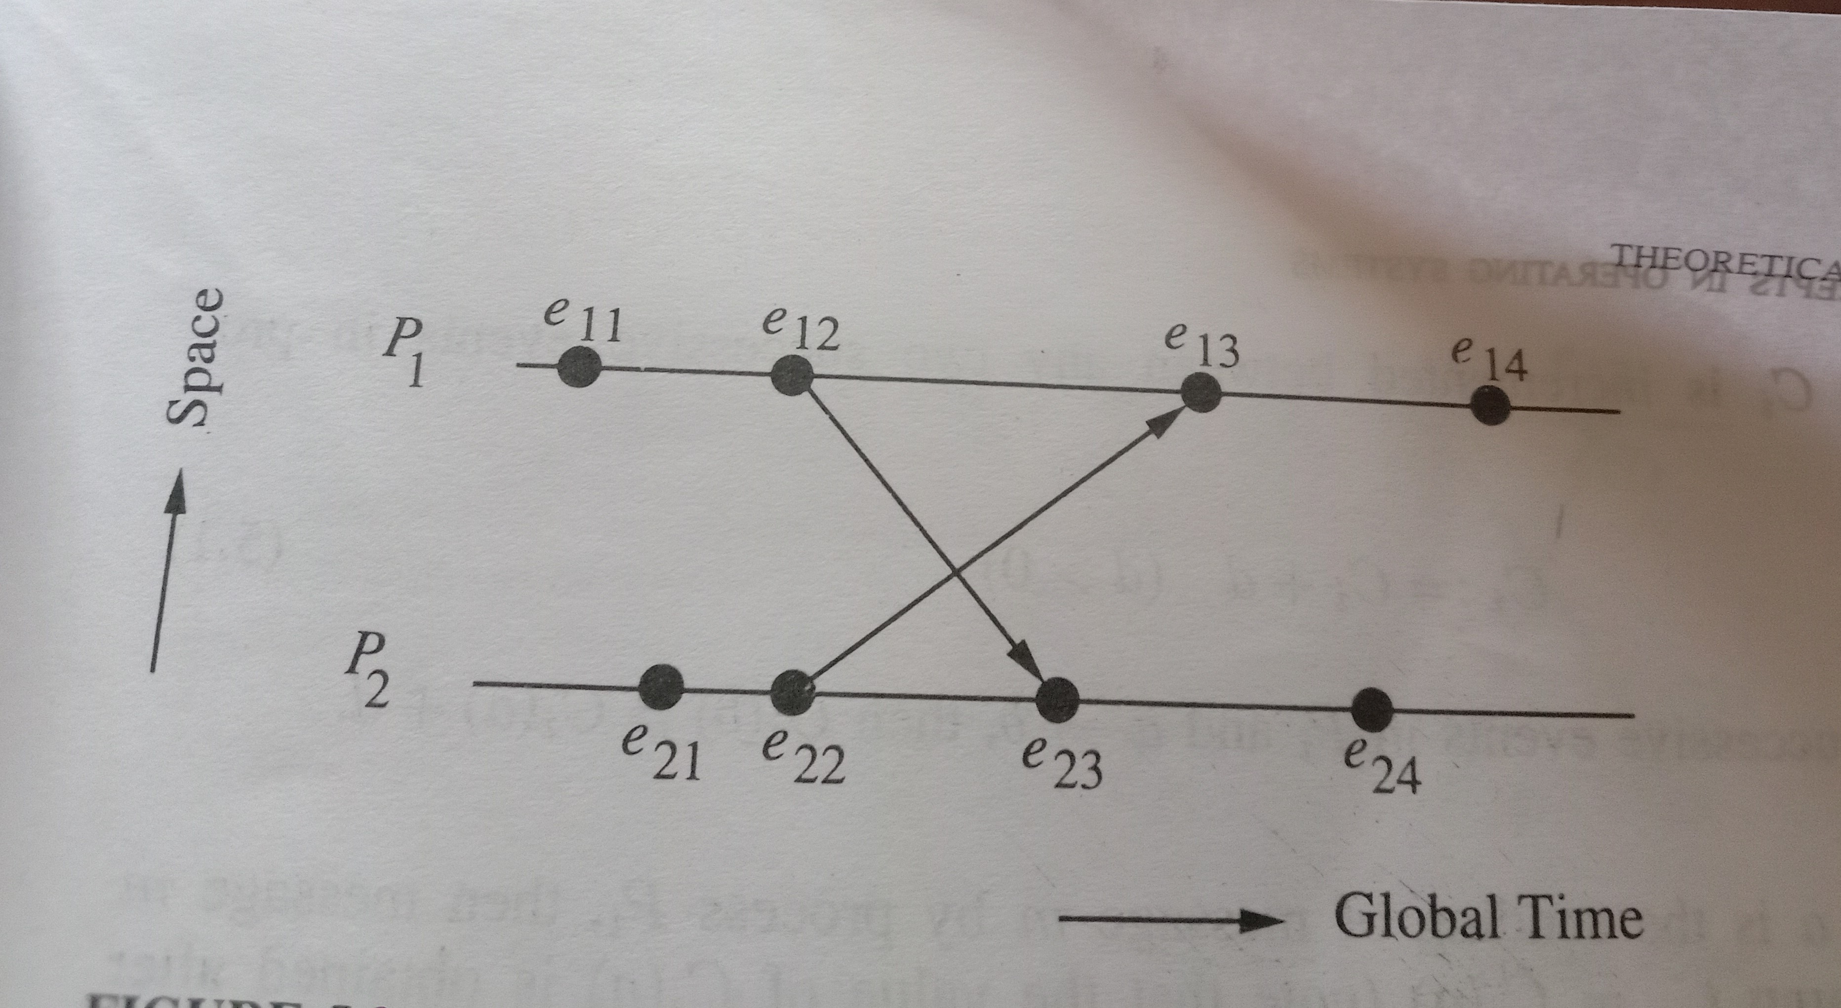
e11,e12,e13,e14 are events in process P1 and e21,e22,e23 and e24 are events in process P2. The arrows represent message transfers between the processes. For eg,arrow e12e23 correspondings to a message sent from process P1 to process P2.e12 is a the event of sending the message at P1 and e23 is the event of receiving the same message at P2

Slide 53
In the figure we see that e22->e13, e13->e14 therefore e22->e14
In other words,event e22 causally affects event e14.

Slide 54
Logical Clocks
In order to realize the relation -> Lamport introduced the following system of logical clocks.
There is a clock Ci at each process Pi in the system.The clock Ci can be thought of as a function that assigns a number Ci(a) to any event a,called the timestamp of event a at Pi.
The numbers assigned by the system of clocks have no relation to physical time and hence the name logical clocks.
The logical clocks take monotonically increasing values.
Clocks can be implemented by counters.
Timestamp of an event=value of the clock when it occurs

Slide 55
Conditions satisfied by the system of clocks?
For any events a and b:
If a->b,then C(a)<C(b)
The happened before relation ‘->’ can now be realized by using logical clocks if the following two conditions are met:
[C1] For any two events a and b in a process Pi,if a occurs before b,then
Ci(a)<Ci(b)
[C2] If a is a the event of sending a message m in process Pi and b is the event of receiving the same message m at process Pj,then
Ci(a)<Cj(b)

Slide 56
[C3]: A clock Ci associated with a process Pi, must always go forward , never backward, That is, corrections to time of a logical clock must always be made by adding a positive value to the clock , never by subtracting the value.

Slide 57
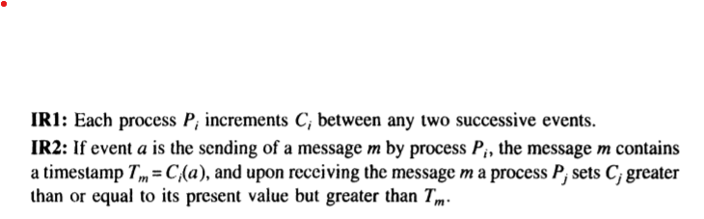
To meet the conditions C1,C2 and C3 Lamport uses the following implementation rules
Rule IR1 ensures that the condition C1 is satisfied and rule IR2 ensures that the condition C2 is satisfied.Both IR1 and IR2 ensures that the condition C3 is satisfied.
Hence the simple implementation of rules IR1 and IR2 guarantees correct system of clocks.

Slide 58
Total ordering of Events
Happened before only as Partial Ordering
Tow or more events A and B are not related before if same timestamps are associated with them.
P1 and P2 clocks are same for examples 100
Nothing can be said about the order
Additional information is required
Lamport proposed total ordering of processes.
He used process identity numbers

Slide 59
Timestamp associated with them will be 100.001 and 100.002
Here process identity number of processes are P1 and P2 are 001 and 002.

Slide 60
VIRTUAL TIME
Lamport’s system of logical clock implements an approximation tglobal/physical time,which is referred to as virtual time.
Virtual time advances along with the progression of events and is therefore discrete.
If no events occur in the system,virtual time stops,unlike physical time which continuously progresses.

Slide 61
A Limitation of Lamport’s Clock
In Lamport’s system of logical clocks,if a->b then C(a)<C(b).
But reverse is not true
If a and b are events in different processes and C(a)<C(b),then a->b is not necessarily true; events a and b may be causally related or may or may not be causally related.
Thus,Lamport’s system of clocks is not powerful enough to capture such situations.

Slide 62
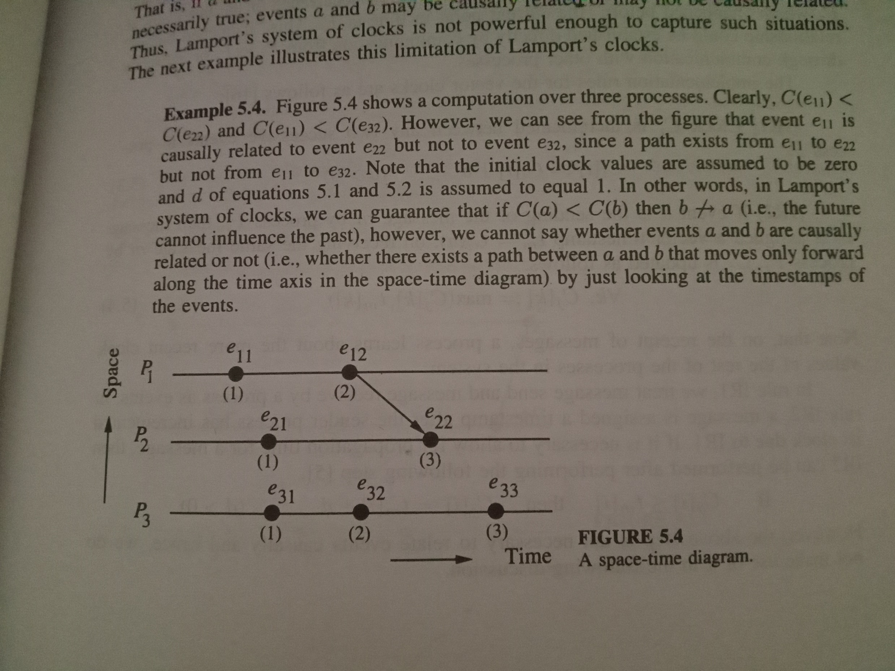

Slide 63
The reason for the above limitation is that each clock can independently advance due to the occurrence of local events in a process and the Lamport’s clock system cannot distinguish between the advancements of clocks due to the local evens from those due to the exchange of messages between processes.
Therefore,using the timestamps assigned by Lamport’s clocks,we cannot reason about the causal relationships between two events occurring in different processes by just looking the timestamps of the events.

Slide 64
Causal Ordering of messages
First proposed by Birman and Joseph for ISIS.
The causal ordering of messages deals with the notion of maintaining the same causal relationships that holds among “message send” events with the corresponding “message receive” events.
If Send(M1)->Send(M2)
(where Send(M) is the event sending message (M)) then every receipient of both messages M1 nd M2 must receive M1 before M2.
CAUSAL ORDERING OF MESSAGES SHOULD NOT BE CONFUSED WITH CASUAL ORDERING OF EVENTS
Vector Clocks are used in a distributed systems to determine whether pairs of events are causally related. Using Vector Clocks, timestamps are generated for each event in the system, and their causal relationship is determined by comparing those timestamps.

Slide 65
Techniques for causal ordering of messages are useful in developing distributed algorithms and may simplify the algorithms themselves.
Two protocols that makes use of vector clocks for the causal ordering of messages in the distributed system,
NB: vector clock is used to determine the partial ordering of events in a distributed system and detecting causality violations.

Slide 66
Two protocols that makes use of the vector clocks for the causal ordering of distributed systems
The first protocol is implemented in ISIS,wherein the processes are able to communicate using broadcast messages.
The second protocol does not require processes to communicate only through broadcast messages.
Both protocols-Message should be delivered reliably.
BASIC IDEA-
Deliver a message to a process only if if the messages immediately preceeding it has been delivered to the process.
Otherwise the message is not delivered immediately but is buffered until the message immediately preceeding it is delivered.

Slide 67
A vector accompanying each message contains the necessary information for a process to decide whether there exist a message preceeding it.

Slide 68
Birman-Schiper-Stephenson Protocol
There are three basic principles to this algorithm:All messages are time stamped by the sending process.[Note: This time is separate from the global time talked about in the previous sections. Instead each element of the vector corresponds to the number of messages sent (including this one) to other processes.]
A message can not be delivered until:
All the messages before this one have been delivered locally.
All the other messages that have been sent out from the original processs has been accounted as delivered at the receiving process.
When a message is delivered, the clock is updated.
This protocol requires that the processes communicate through broadcast messages since this would ensure that only one message could be received at any one time (thus concurrently timestamped messages can be ordered).

Slide 69
